Slide 1




EasyPG PG MANAGEMENT SYSTEM
Stay Smart. Manage Smarter.

Slide 2


TABLE OF CONTENTS
01
02
03
04
Introduction
UML Diagrams
Database
Design
UI
Design

Slide 3


Why This Project? (The Problem)
Difficulty for outstation students to book PG rooms remotely.
No formal rent payment tracking or reminders.
No structured complaint/maintenance resolution process.
PG owners struggle with Excel-based record keeping and tenant management.
Lack of visibility and online reach for PGs.

Slide 4
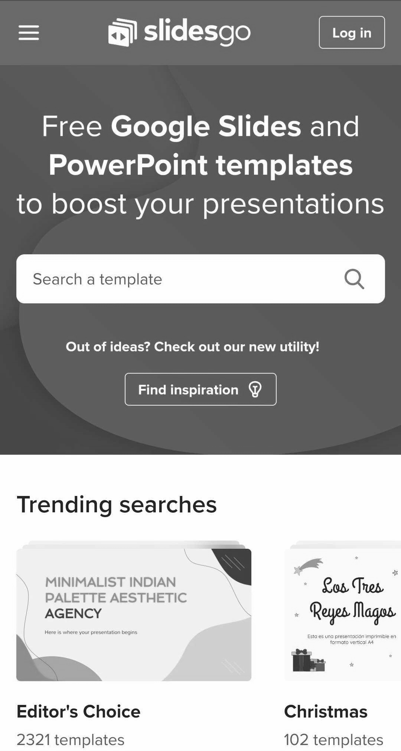
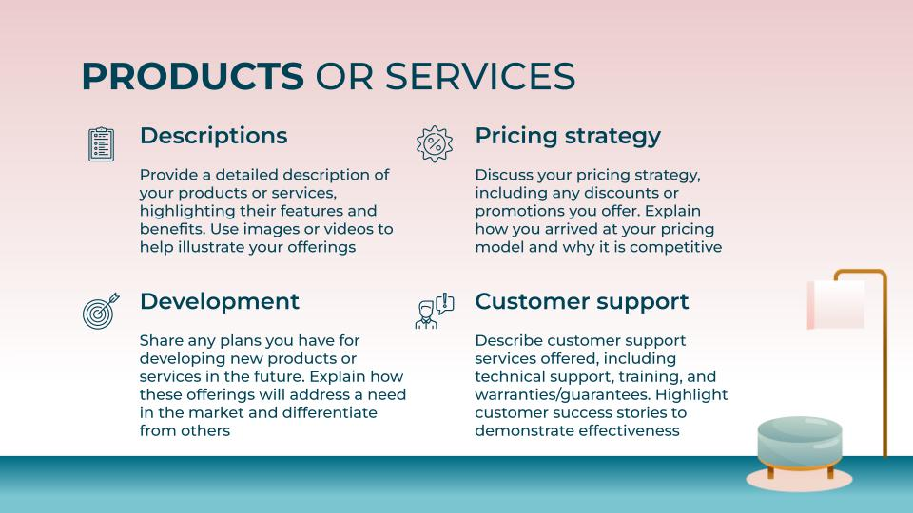


What We’re Building (The Solution)
Online platform for:
Room search and user registration.
Tenants to book rooms, pay rent, raise and track complaints.
Admins to manage rooms, bookings, complaints, and rules.
Techstack for the project:
Frontend: React.js – clean UI, responsive design.
Backend: Spring Boot – RESTful APIs and business logic.
Database: MySQL – structured and relational data storage.

Slide 5
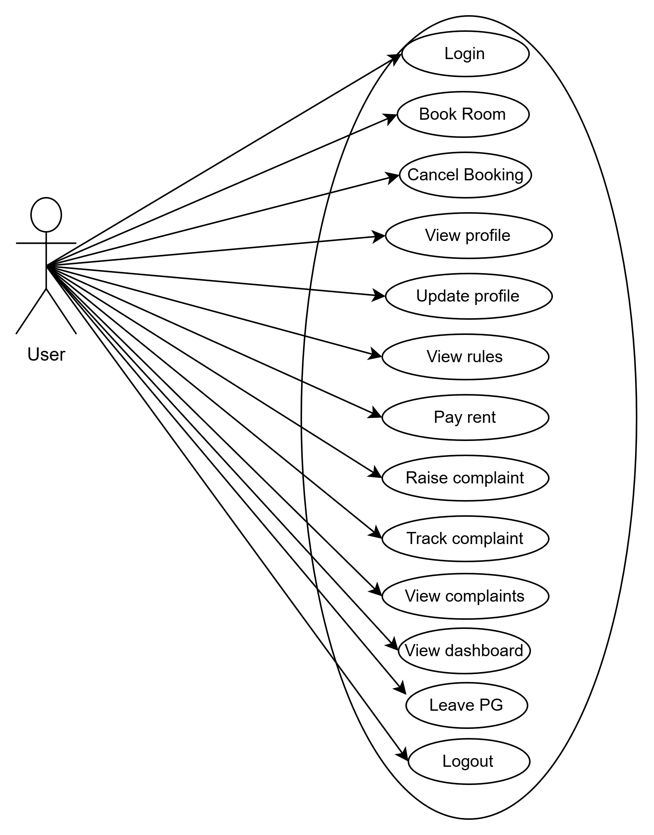
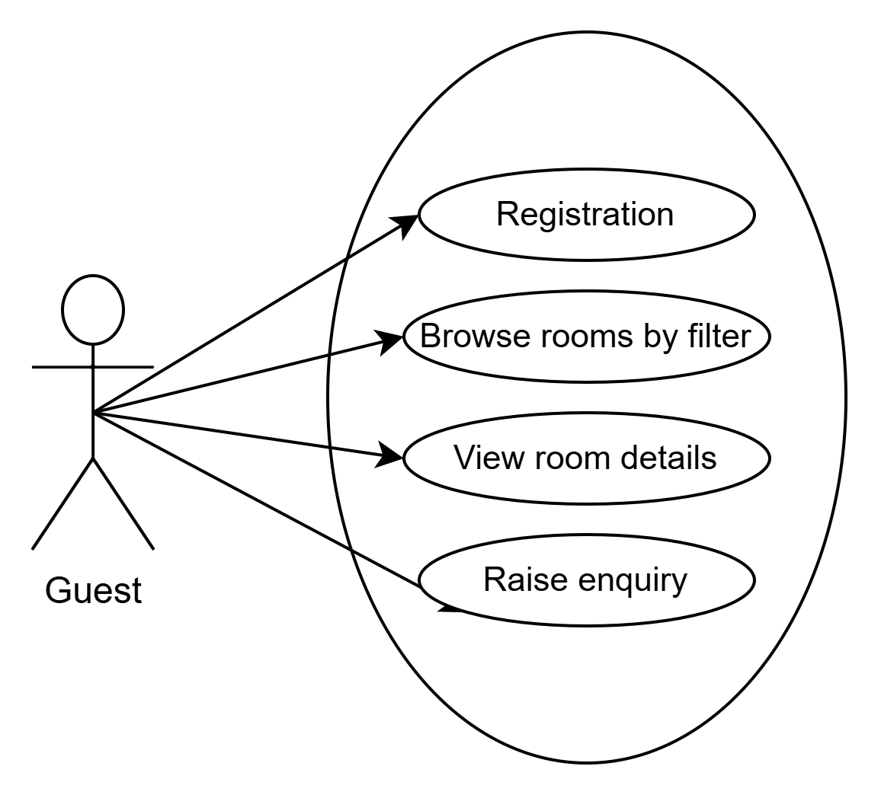
UML Diagram

Slide 6
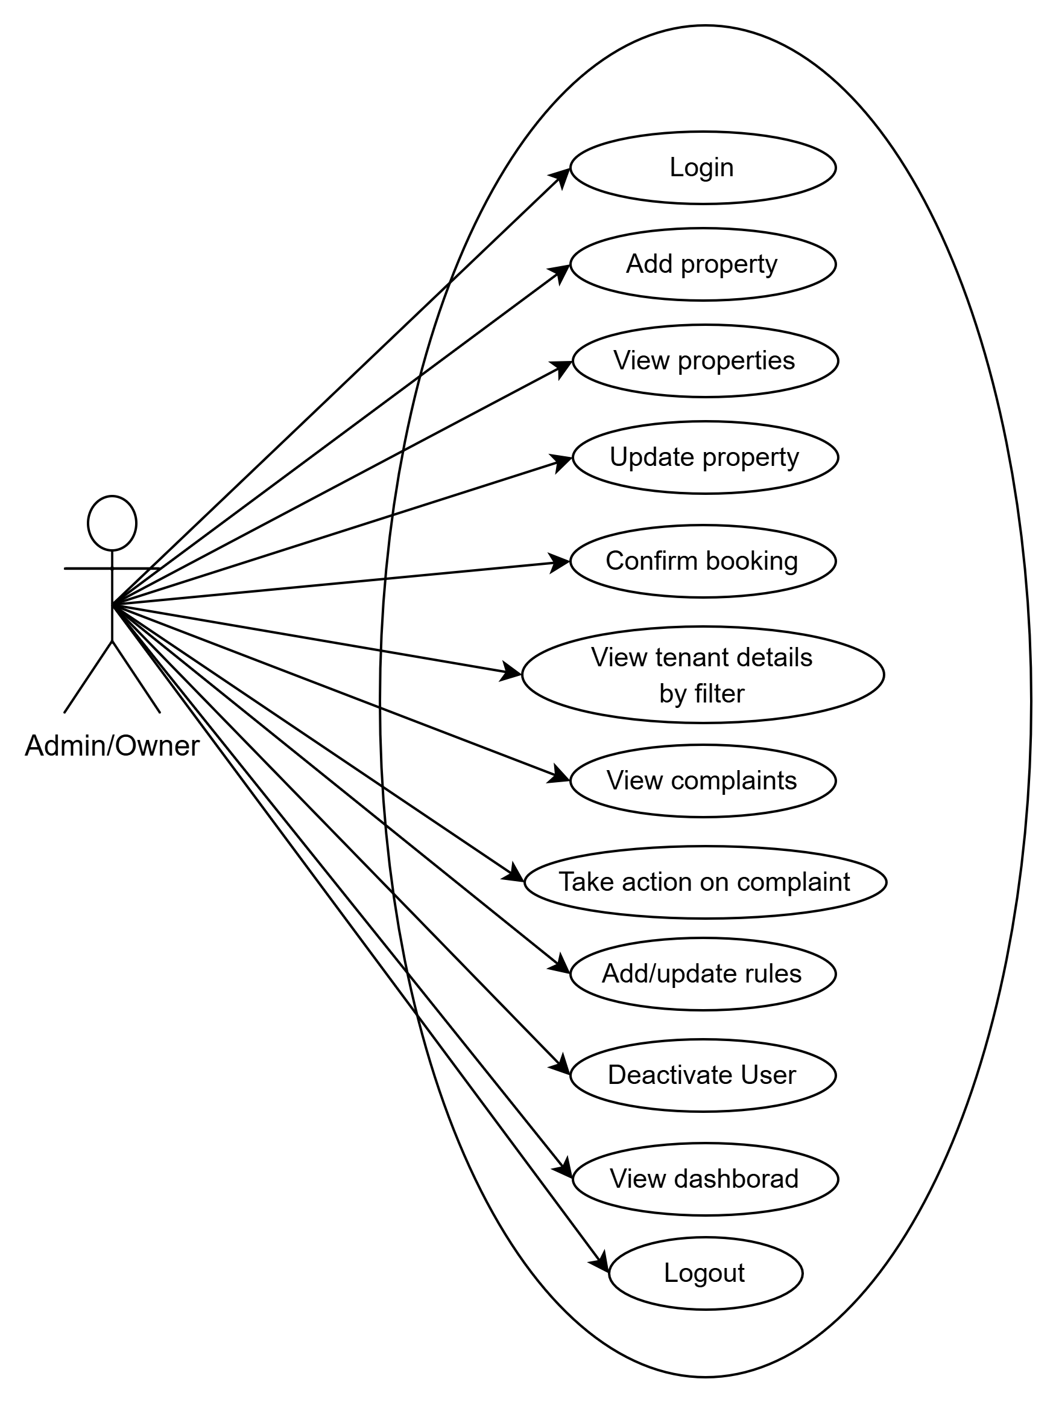

Slide 7
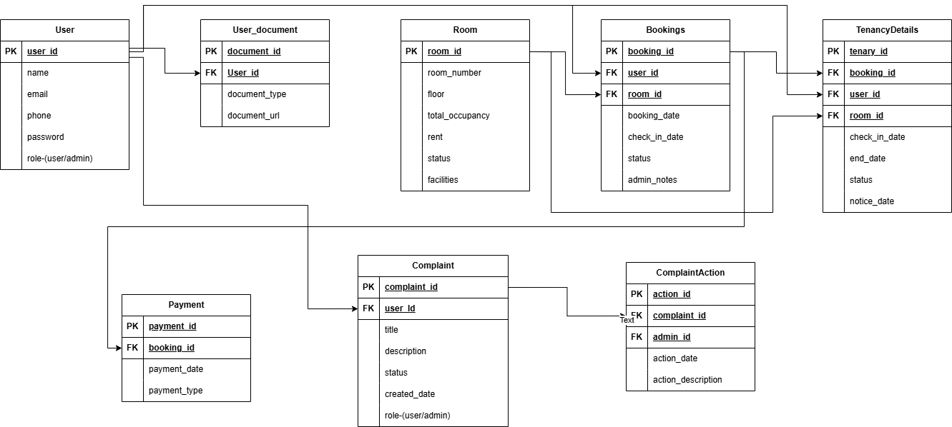
ER Diagram

Slide 8
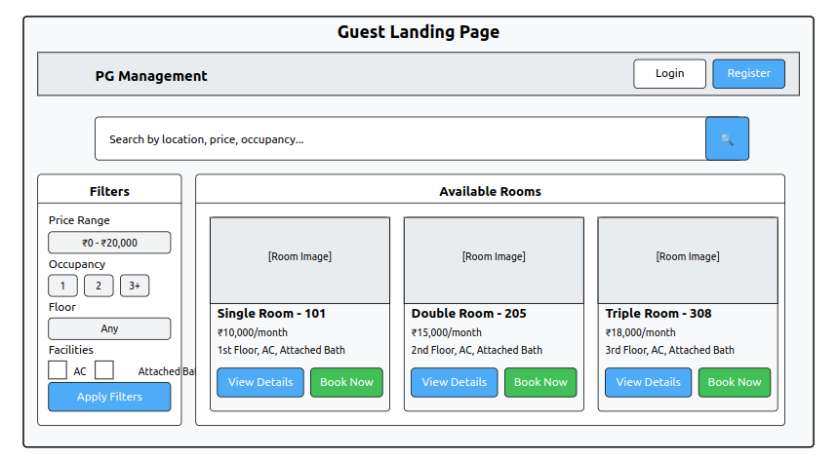
UI Design

Slide 9
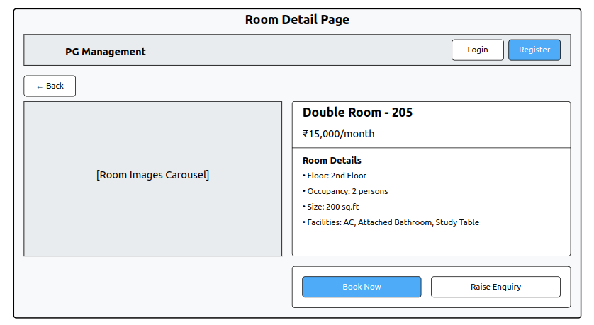

Slide 10
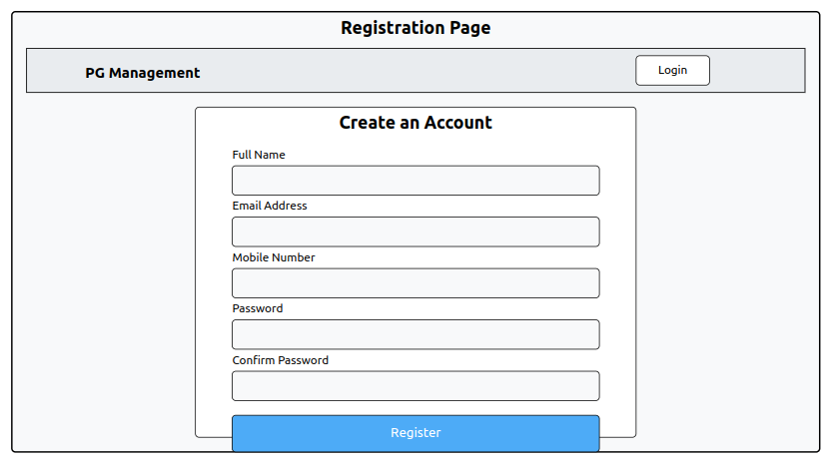

Slide 11
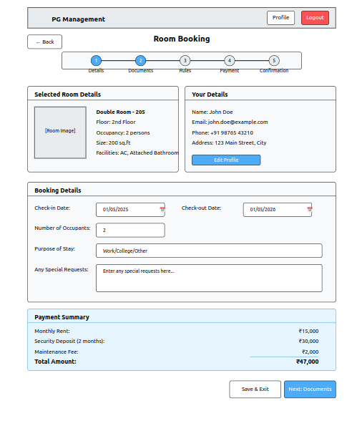

Slide 12
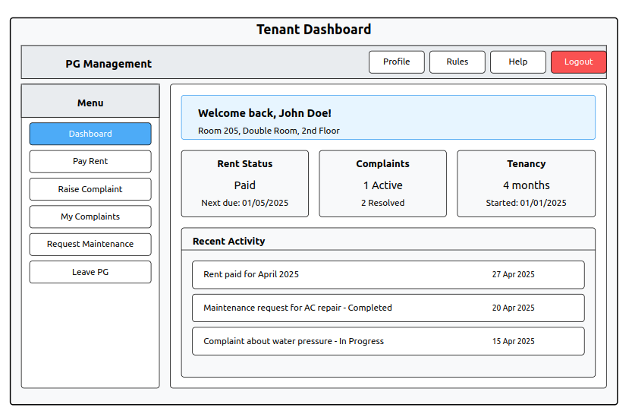

Slide 13
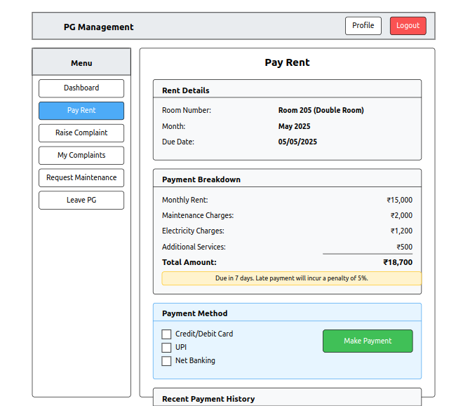

Slide 14
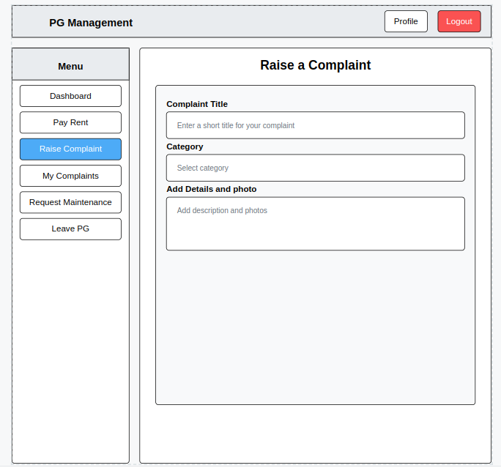

Slide 15
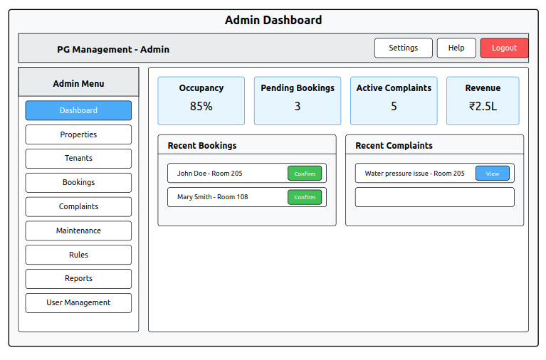

Slide 16
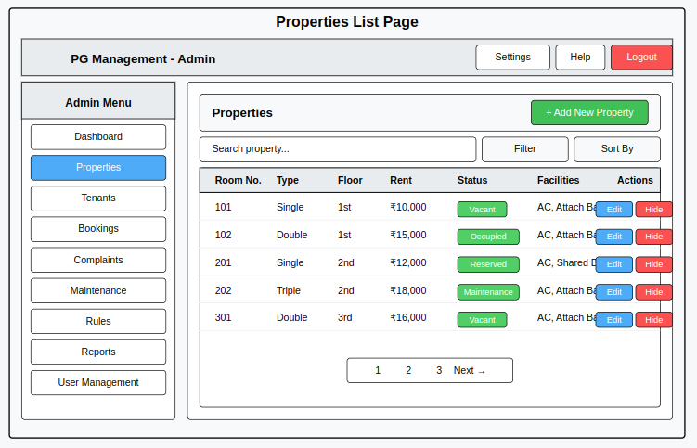

Slide 17
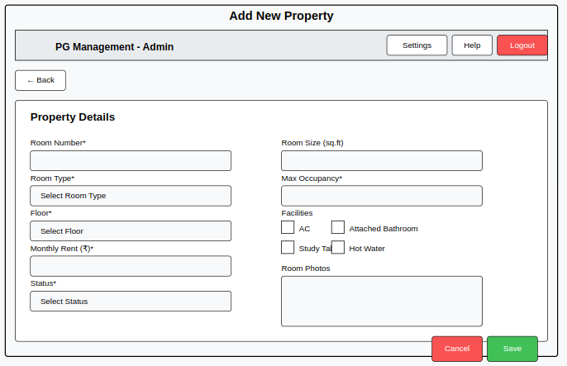

Slide 18
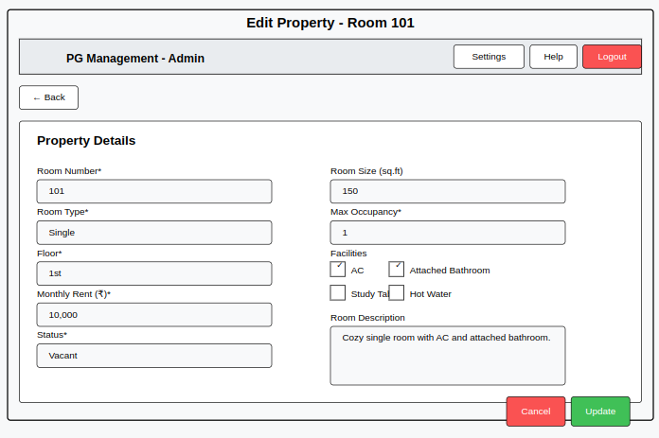

Slide 19
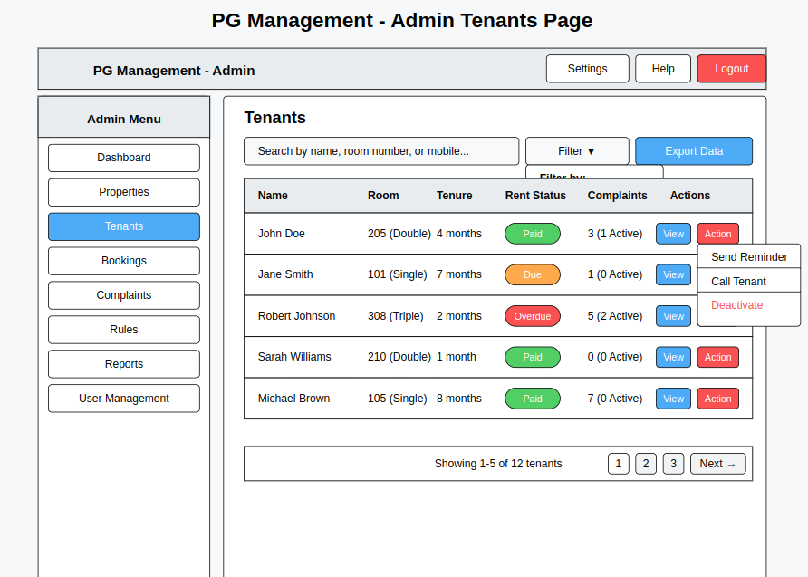

Slide 20
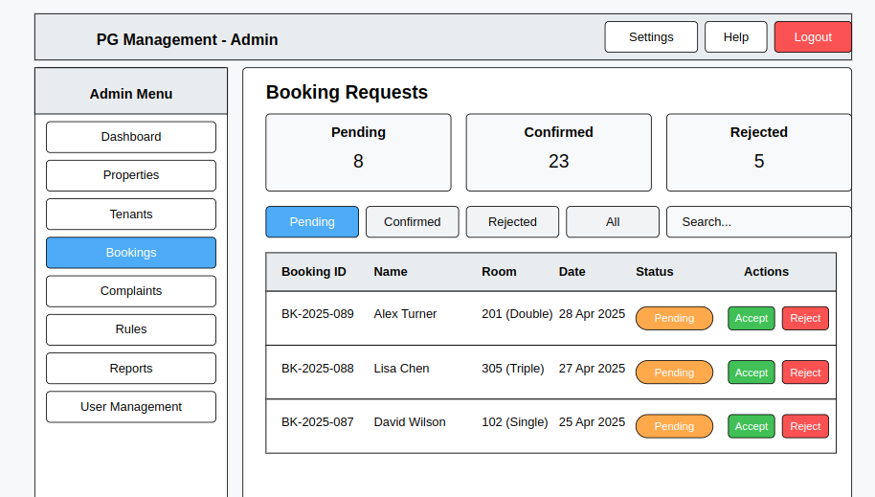

Slide 21

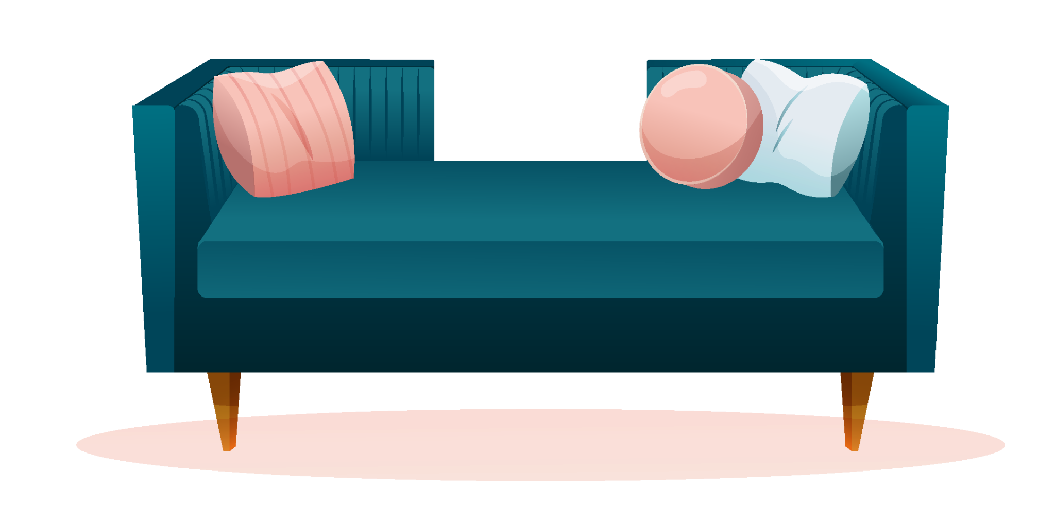
THANKS!

